Slide 1
CMP203 Graphics Programming
Vertex Arrays
And
Procedural Generation

Slide 2
This Week
Vertex arrays
Introduction
Implementation in OpenGL
Different Methods
Problems
Procedural generation
Disc
Sphere
Cylinder
Texturing
Techniques

Slide 3
Current method
In OpenGL
Drawing an object relies on a large amount of function calls
glBegin(), glEnd(), glVertex3f(), glNormal3f(), glTexcoord2f()
Drawing a cube (lit and textured) contains over 70 function calls (per frame)
Function calls have an overhead associated with them. If we can reduce the amount of function calls we can speed up our application

Slide 4
Vertex Arrays
Concept
Build arrays with the data required to build the geometry
Don’t render with individual calls to vertex, normal, texcoords etc
In some cases we can reuse vertices

Slide 5
Vertex Arrays
Array types
Vertex Information
Colour Information
Normals
Texture Coordinates
Indices (Index)

Slide 6
Vertex arrays
Overview of using vertex arrays
Create arrays containing the data
Enable the use of arrays for rendering
Point to the data arrays
Draw the geometry (data from the arrays)
Disable drawing from arrays

Slide 7
Vertex arrays
Three ways of drawing the geometry
Accessing individual array elements
Lots of randomly jumping around
Draw based on Vertex array order
Hopefully you built the data array in the right order
Create a Index array and use that to guide drawing order

Slide 8
Vertex Arrays
Uses
Can speed up drawing complex objects considerably
Data remains dynamic so the vertex information can still be manipulated
Can be used to store externally loaded model files or generated shapes

Slide 9
A simple shape
Build a simple quad face using vertex arrays
What we need
Arrays filled with data
A function to render the shape

Slide 10
Quad array
Float verts[] = {x, y, z, x, y, z, x, y, z, ...};
Float normals[] = {nx, ny, nz, nx, ny, nz, ...};
Float texCoords[] = {u, v, u, v, u, v, ...};
Positions in the arrays are very important
The first three values from verts (x, y, z) are linked to the first three values of normals (x, y, z)
And to the first two values of texCoords

Slide 11
Vertices
extern float verts[] = {-1.0, 1.0, 1.0,//Vertex #1
-1.0, -1.0, 1.0,// Vertex #1
1.0, -1.0, 1.0,// Vertex #2
1.0, 1.0, 1.0,// Vertex #3
};

Slide 12
Normals
extern float norms[] = { 0.0, 0.0, 1.0,//0
0.0, 0.0, 1.0,//1
0.0, 0.0, 1.0,//2
0.0, 0.0, 1.0,//3
};

Slide 13
Texture coordinates
extern float texcoords[]= {0.0, 0.0, //0
0.0, 1.0, //1
1.0, 1.0, //2
1.0, 0.0, //3
};

Slide 14
The choice is yours
Three ways of drawing the geometry
Accessing individual array elements
Draw based on Vertex array order
Create a Index array and use that to guide drawing order
Examples for all 3, only really difference is how the shape is rendered

Slide 15
Method 1, 2 and 3
Step 0: Create and fill arrays with vertex, normal and texture data
Step 1: Enabling the arrays
We must tell OpenGL which arrays we will be using
glEnableClientState()
Usually we activate 1 to 4 arrays
GL_VERTEX_ARRAY
GL_INDEX_ARRAY
GL_NORMAL_ARRAY
GL_TEXTURE_COORD_ARRAY
Set up these arrays we can create objects with normals and texture coordinates

Slide 16
Method 1, 2 and 3
Step2: Specifying data for the arrays
Tell openGL what information we have
glEnableClientState(GL_VERTEX_ARRAY);
Etc
Tell openGL what data and how it is arranged
glVertexPointer(3, GL_FLOAT, 0, verts);
etc
Dereferencing method goes here (how to render this data)
Turn off
glDisableClientState(GL_VERTEX_ARRAY);

Slide 17
Method 1
Dereferencing and rendering
“Dereferencing” refers to this practice of taking the array data from the “client” side and sending it to the graphics pipeline
Method 1: Dereferencing single array elements
glArrayElement(number);
Adding a number into this function will access the appropriate information in the set-up vertex arrays
No indices required

Slide 18
Method 1
Using the arrays we setup
glBegin( polygon layout );
glArrayElement(2);
glArrayElement(3);
glArrayElement(5);
glEnd();
This is the same as specifying a glVertex3f(), glNormal3f() and glTexCoord2f() for 3 vertices

Slide 19
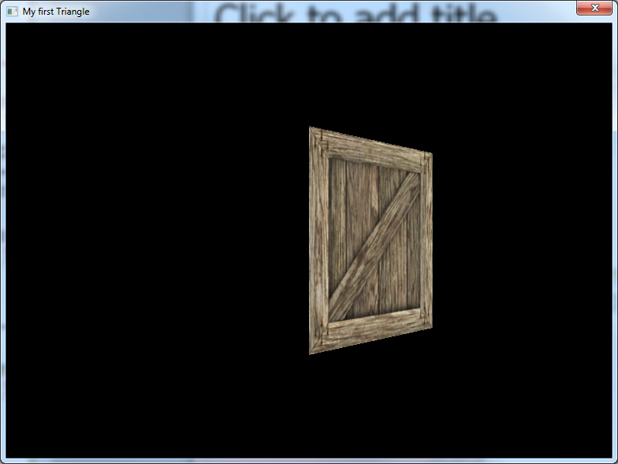

Slide 20
Method 2
Same setup as method 1 (data arrays etc)
Accessing full arrays with a single function call
glDrawArrays(type, offset, count)
glDrawArrays(GL_TRIANGLES, 0, 6);
glDrawArrays does not lie within a glBegin()/glEnd()
Does not require an Index array
But Vertex array order is VERY important

Slide 21
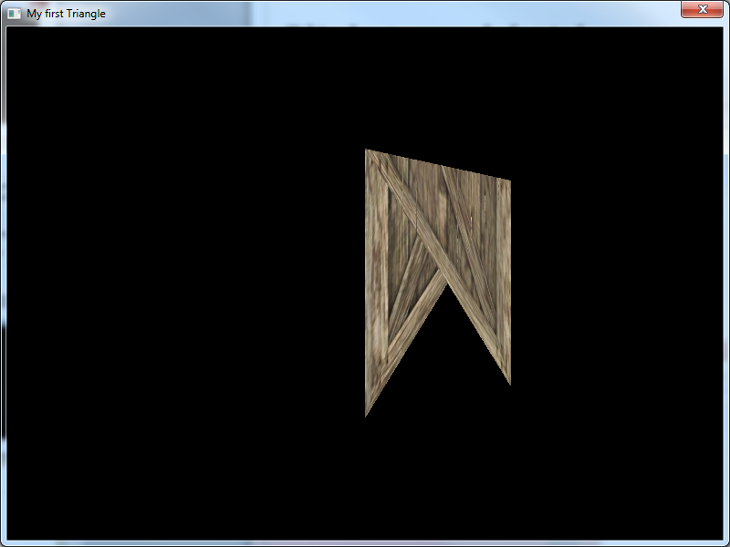

Slide 22
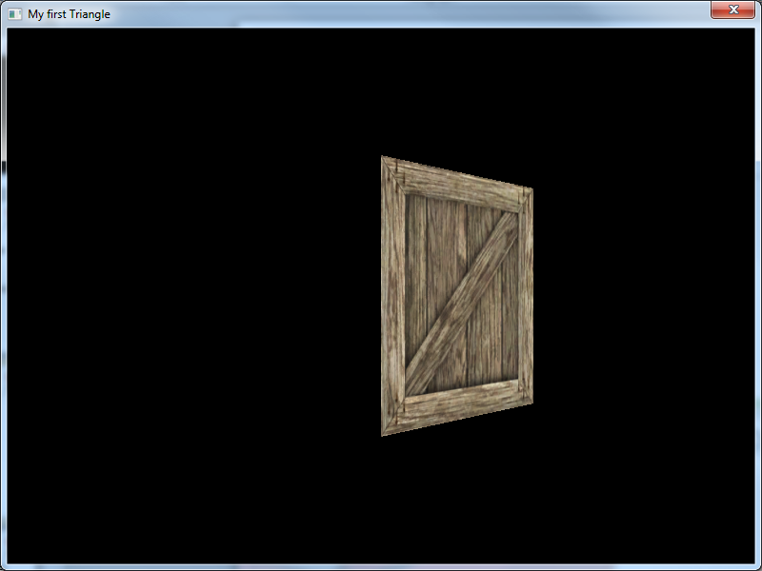

Slide 23
Method 3
Same setup as method 1 & 2 (data arrays etc)
Accessing full arrays with a single function call
glDrawElements(mode, count, type, indices)
Requires index array
For example
glDrawElements(GL_QUADS, 24, GL_UNSIGNED_BYTE, INDEX_ARRAY);
Note: glDrawElements does not lie within a glBegin()/glEnd()

Slide 24
Index array
extern GLubyte indices[]={0, 1, 2,//front
0, 2, 3,
};

Slide 25
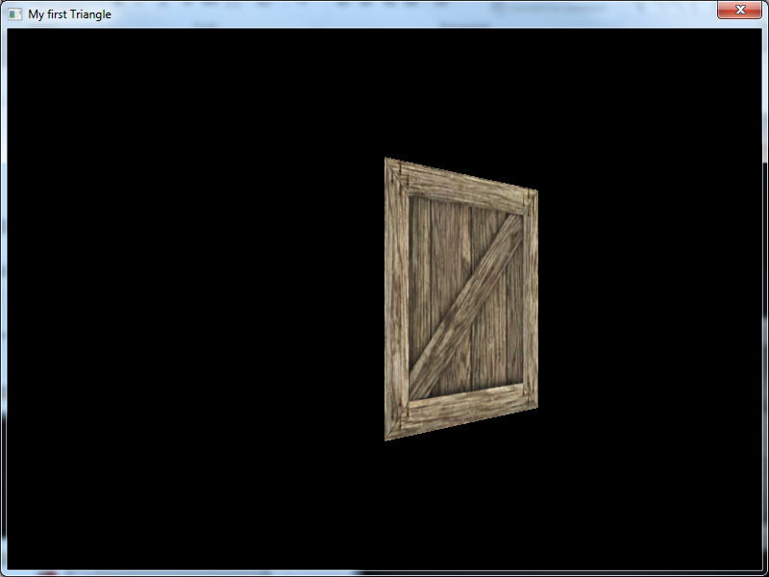

Slide 26
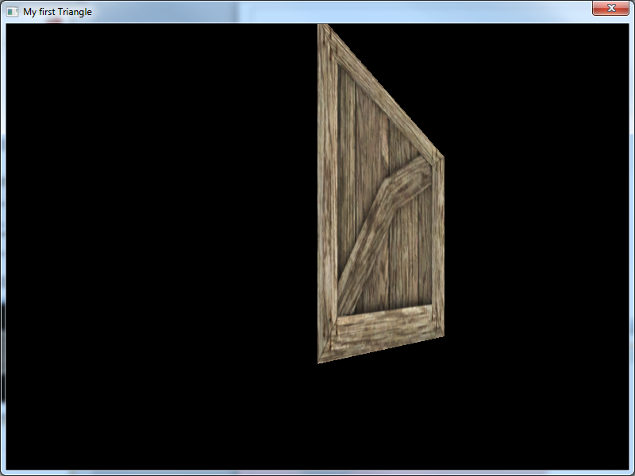

Slide 27
Outline of the render function
glEnableClientState(GL_VERTEX_ARRAY);
glEnableClientState(GL_NORMAL_ARRAY);
glEnableClientState(GL_TEXTURE_COORD_ARRAY);
glVertexPointer (3, GL_FLOAT, 0, verts);
glNormalPointer (GL_FLOAT, 0, normals);
glTexCoordPointer(2, GL_FLOAT, 0, texCoords);
//dereferencing method of choice
glDisableClientState(GL_VERTEX_ARRAY);
glDisableClientState(GL_NORMAL_ARRAY);
glDisableClientState(GL_TEXTURE_COORD_ARRAY);

Slide 28
Vertex Arrays
Example code
Self contained within two files
shape.cpp and shape.h
Three functions
Render1()
Render2()
Render3()
Vertex arrays are stored locally in the .cpp file
Reason for separation
Easier to integrate into your existing code if you wish
Basis for a potential “Pre-fabricated” object library

Slide 29
Issues
Previously I said we can reuse vertices
However it can only be done on certain shapes
Let’s see
Let’s try it with a cube

Slide 30
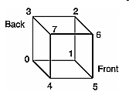
Code that we need
Create and fill vertex array
For a cube
Vertex array has 8 vertices in it (0-7)
float CUBE_VERTS[] = {
-1.0, -1.0, -1.0, // vertex #0
1.0, -1.0, -1.0, // vertex #1
1.0, 1.0, -1.0, // Vertex #2
-1.0, 1.0, -1.0, // Vertex #3
-1.0, -1.0, 1.0, // Vertex #4
1.0, -1.0, 1.0, // Vertex #5
1.0, 1.0, 1.0, // Vertex #6
-1.0, 1.0, 1.0}; // Vertex #7

Slide 31
Some more code
Just like the Vertex data we need arrays for
Normal data
Texture coordinates
Colour
Indices

Slide 32
More code
GLubyte CUBE_INDICES[]={ 1, 0, 2, //front
2, 0, 3,
4, 5, 7, //back
7, 5, 6,
0, 4, 3, //left
3, 4, 7,
5, 1, 6, //right
6, 1, 2,
7, 6, 3, //up
3, 6, 2,
1, 0, 5, //down
5, 0, 4 };

Slide 33
Vertex Arrays
Example Code
4 arrays representing cube data
Index
Vertices
Texture coordinates
Normals
1 draw function
glDrawElements()
By these 5 powers combined…

Slide 34
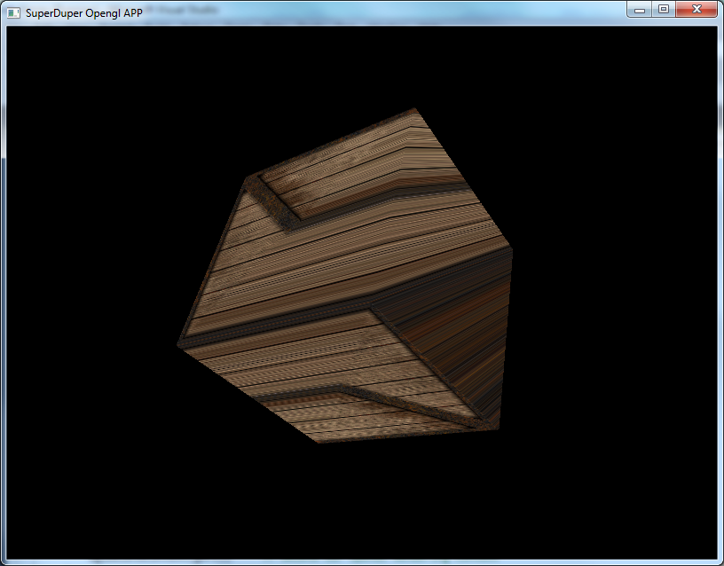
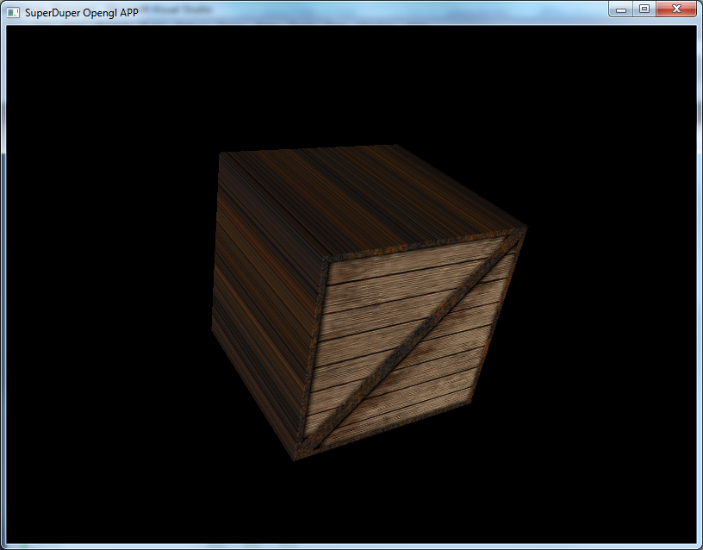

Slide 35
Vertex Arrays
What went wrong?
Cube is one of the worst case scenarios when trying to reuse vertices
Each array MUST be the same size as the vertex array
Therefore there are only 8 normals
Only 8 texture coordinates
We cannot represent this object properly with only 8 vertices
Objects that are not so sharp work better
The vertex position, normals and texture coordinates can be shared

Slide 36
Vertex Arrays
Possible solutions
Render each side as a separate Vertex array
Requires a separate index array for each side
We can reuse texture coordinates
But we would have to set up a new normal array for each side.
This means 6 function calls instead of 1, but this is still better than 70+
Store additional vertex information
Memory is not such a big issue
Store additional vertices for every vertex that requires different texture coordinates / normals
This means upping the array size to 24
Commonly used in model formats as a solution

Slide 37
Vertex arrays
Additional reading can be found here: http://www.glprogramming.com/red/chapter02.html#name6

Slide 38
Procedural generation
Procedural models
Disc
Sphere
Cylinder
Texturing and lighting
Techniques

Slide 39
Procedural Models
Definition
Pre-Fabricated: Models loaded in from file or defined manually in code (our crate or loaded model)
Procedural: Model data that is created Algorithmically and appearance is controlled by the code itself

Slide 40
Procedural Models
Why would we want to use them?
Relatively simple to create and does not require the effort from an Artist
If it is procedural then we can typically alter the resolution of the model (in polygons) to suit the speed of the application
We can alter the attributes of the object to alter its size and shape in code

Slide 41
Procedural Models
Procedural Models tend to be simple geometric shapes
Usually the easiest ones to create are based on some aspect of circular geometry
Such as
Disc
Sphere
Cylinder
etc
Having a library of these objects that we can use in our applications would be useful

Slide 42
How?
Using the parametric equations of shapes we can generate vertices
Connect them to create polygons, building our shape
We can render the shape as we generate it
Not super efficient, depending on the shape
Should store shape data in a vertex array or some other form of data storage
We will discuss how to generate the shapes
You will decide how best to store them

Slide 43
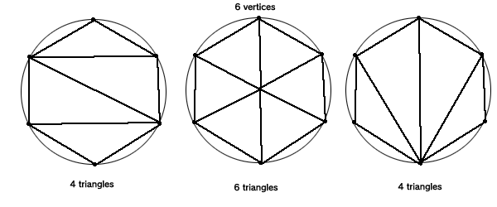
Disc
A simple 3D construction
Resembles a filled circular section of flat geometry
Not as obvious to construct as you might think

Slide 44
Disc
For simplicity, we will use the second method using a central vertex
We will use the parametric equation of a circle to find the vertices
X = rCosTheta
Y = rSinTheta
Radius = r
Angle around circle = Theta

Slide 45
Disc
The first step is to decide how many vertices we are going to use (Resolution) for our model
We need at least 3 to create a valid triangle
Vertices will be sampled at equal distances around the circle

Slide 46
Disc
Algorithm (20 vertices)
Interval between samples is (2*PI) / 20
Loop for number of segments
Begin sampling at angle 0
Calculate 3 vertices
(0, 0, 0) centre of disc
x, y, z based on angle of 0 (first outer vertex)
X, y, z based on angle plus interval (next outer vertex)
Increase angle by interval
(To avoid problems it is sometimes best to clamp the last value back to zero)

Slide 47
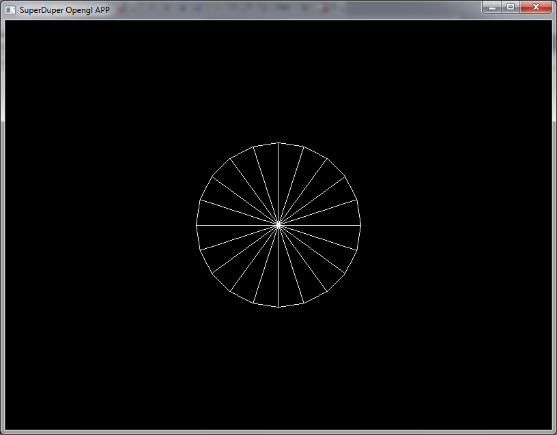

Slide 48
Disc
What about normals and texture coordinates?
Normals will all point positive in the Z-axis
Assuming the disc is built around the XY-axis
Texture coordinates are quite straight forward, surprisingly

Slide 49
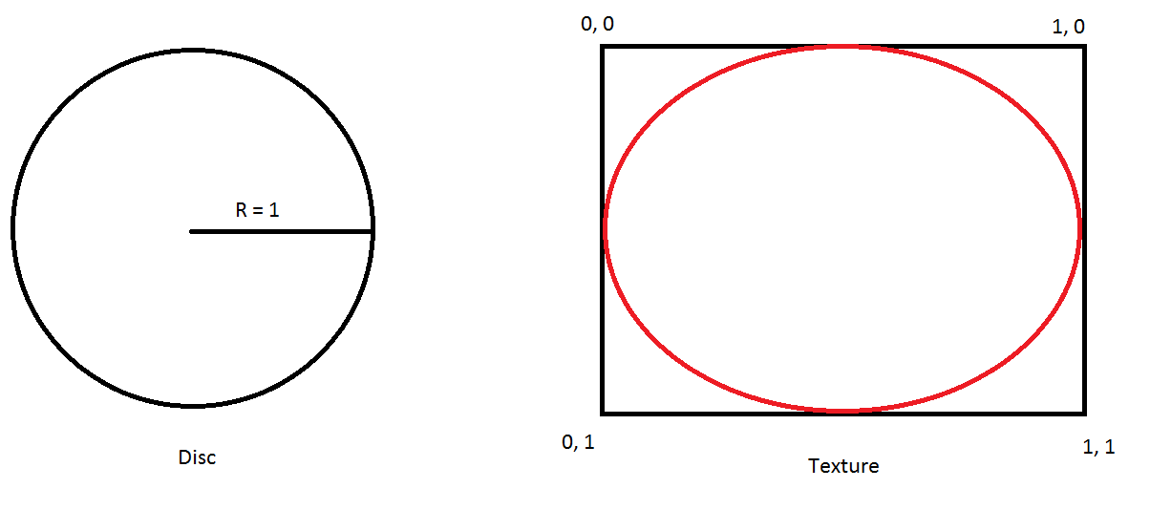
Disc texture coordinates

Slide 50
Making the array
While looping through the array calculating the Vertex positions, use those values to calculate the texture coordinates
The maths
U = ( cos(theta) / d ) + 0.5
V = ( sin(theta) / d ) + 0.5
D is diameter

Slide 51
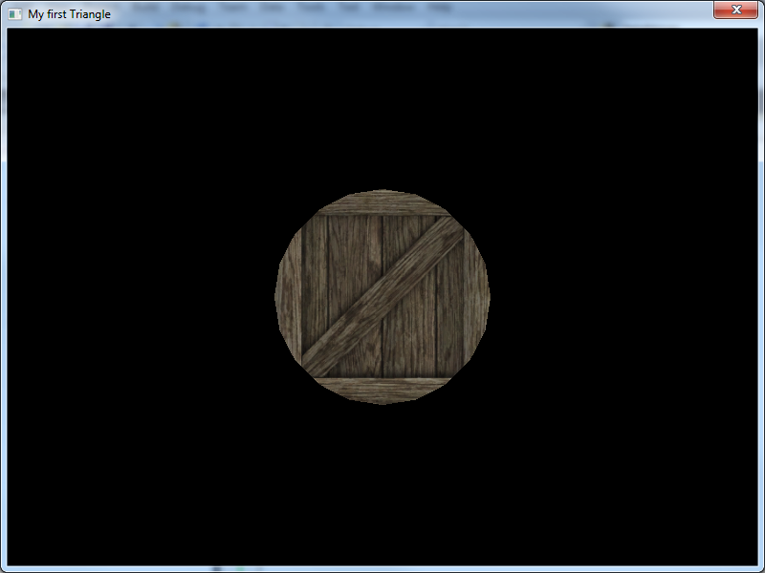

Slide 52
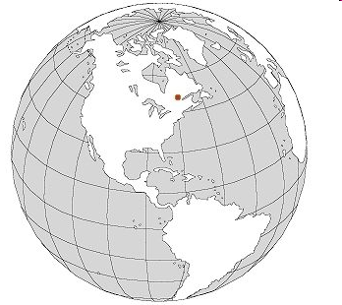
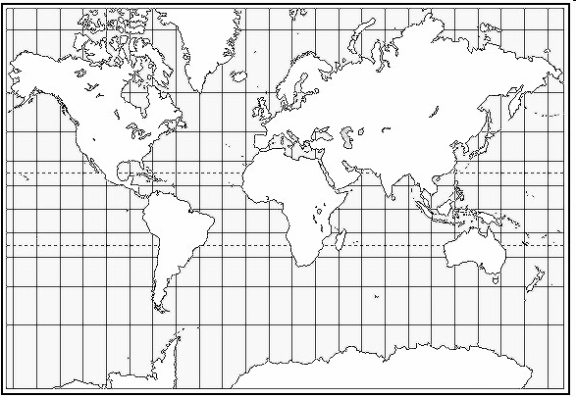
Sphere
Our sphere object is split into sections of Latitude and longitude, exactly like a globe
Very easy to store the information, as it perfectly resembles a 2 Dimensional grid when the sphere is “Unwrapped” (2D Array)

Slide 53
Sphere
Generation
This time we must decide how many divisions of longitude and latitude to create
We use the Parametric equation of a sphere
X = rCosTheta*SinDelta
Y = rCosDelta
Z = rSinTheta*SinDelta
Angle of Latitude = Theta
Angle of longitude = Delta
Using this we can obtain any point in x,y,z coordinates for any given latitude and longitude
We use two loops: One for Longitude and one for latitude to generate the vertex data, normals and texture coordinates

Slide 54
Sphere
Rendering
Theta = (2*pi) / number of segments
Delta = pi / number of segments
Loop for longitude
Loop for latitude
Calculate x, y and z for 4 vertices
[lats][longs]
[lats][longs+1]
[lats+1][longs+1]
[lats+1][longs]
Render face
Increment latitude
Increment longitude

Slide 55
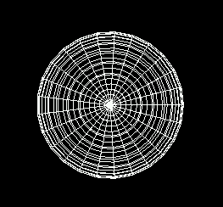

Slide 56
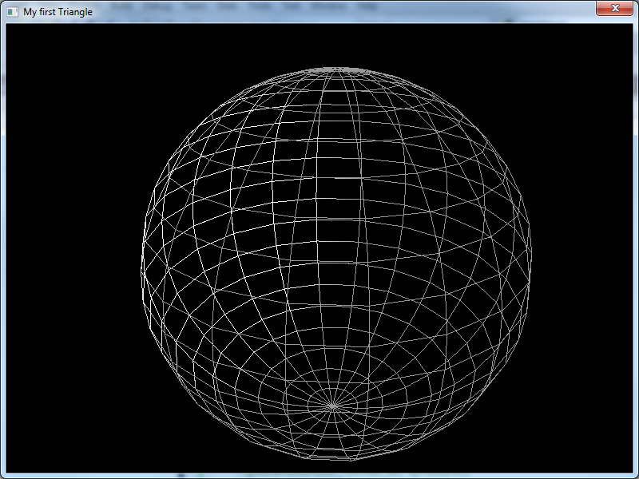

Slide 57
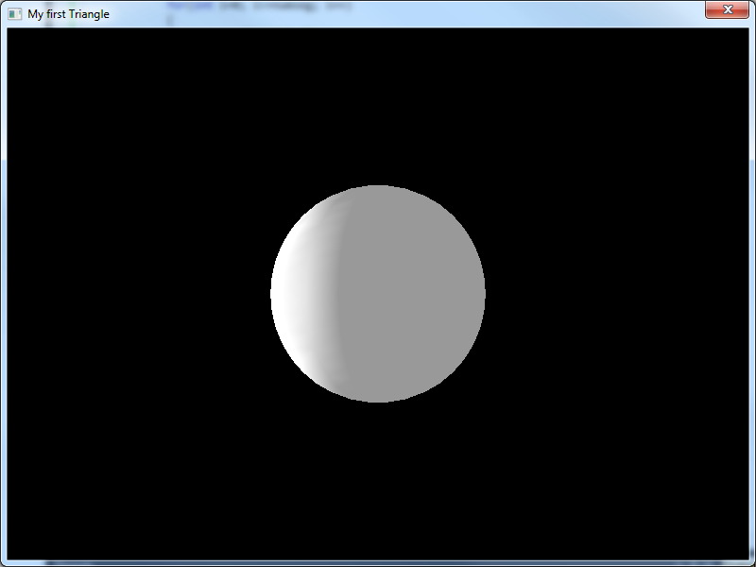

Slide 58
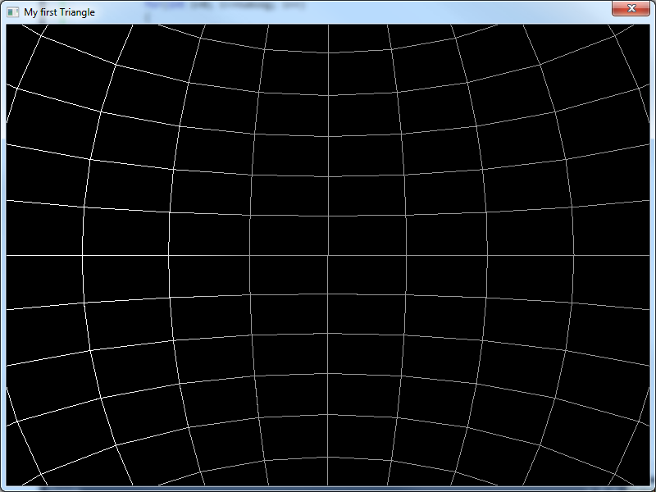

Slide 59
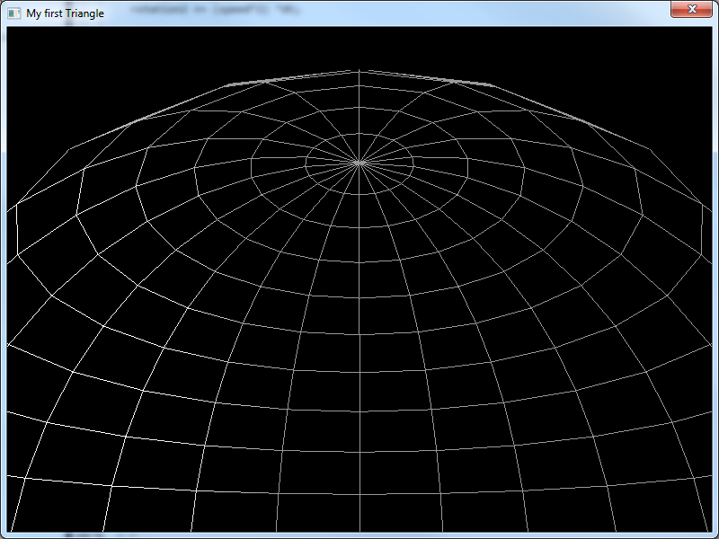

Slide 60
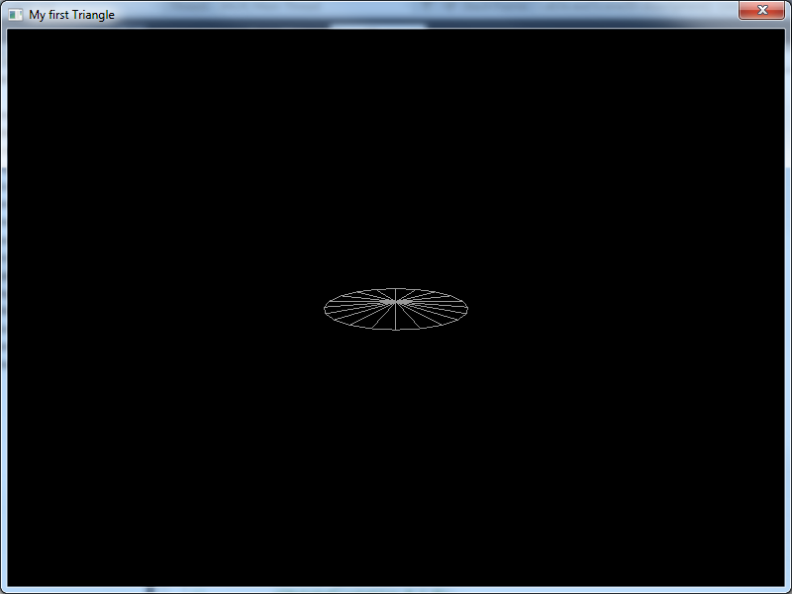

Slide 61
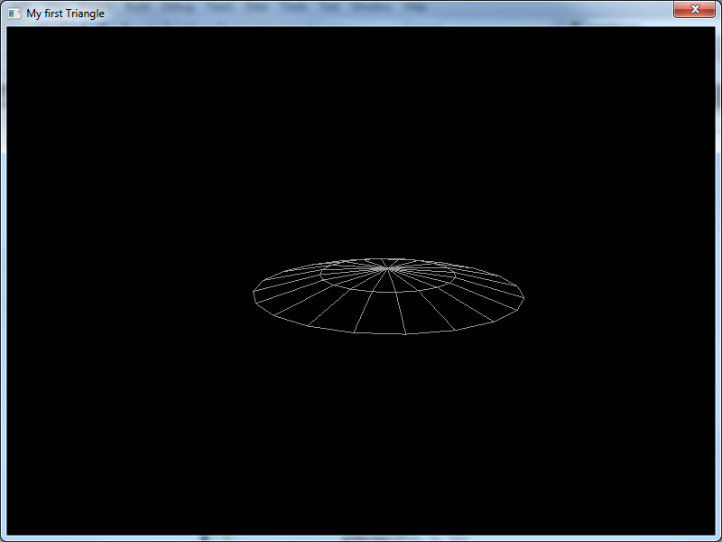

Slide 62
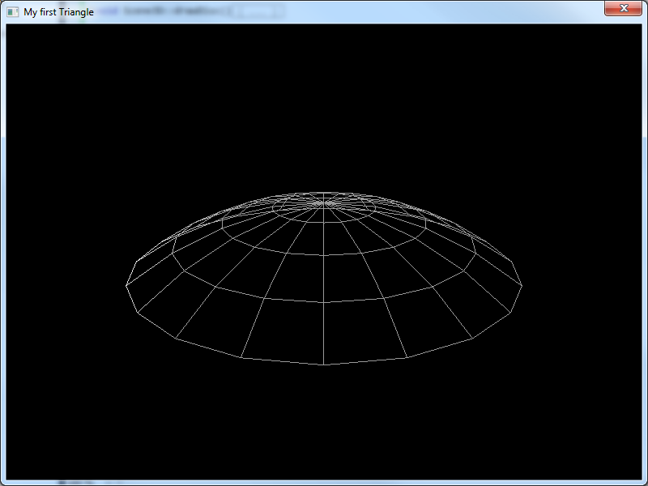

Slide 63
Helpful tips
Like the disc, consider breaking down the problem
Draw a segment to double check rendering order and/or generating points
And facing the right way ☺
There are different ways you can generate sphere (along with other shapes)
Geodesic Sphere
Each face is the same size
No pinching of texture
Harder to generate and texture
Cube sphere
A high res cube distorted into a sphere
Mostly even faces

Slide 64
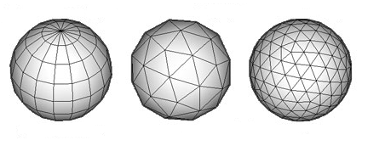
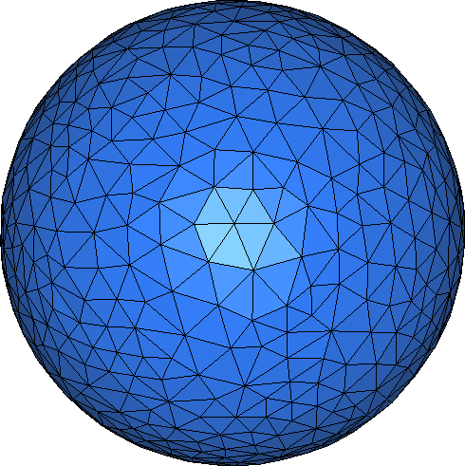
Spheres

Slide 65
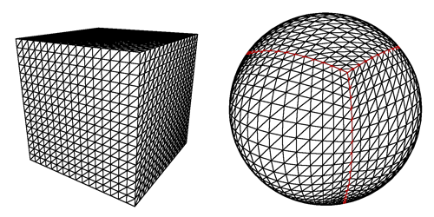
Cube sphere

Slide 66
Cylinder
Generation
Cross between the methods we have used before
Can be represented in a 2D array again
Resolution determines how many stacks/columns we want
Sample the points for a disc
Points are the same all the way up the cylinder
Each stack only requires a new Y value
Y-value is determines by how tall we want the cylinder / how many stacks we want

Slide 67
Cylinder
Rendering
Rendering is achieved in the same way as the sphere
Draw one stack at a time, then move to the next
‘Cap’ the cylinder with a disk at each end

Slide 68
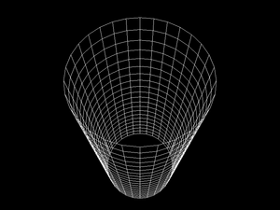

Slide 69
Texturing
Texturing is possible for these objects
Circle / Disc
Already discussed this
Generate UVs based on vertex position
Sphere
Texture coordinates are spread evenly over the 2D array for geometry
So increments for texture coordinates are
1 / amount of lat or long sections
Cylinder
Same as the Sphere

Slide 70
Normals
Disc
All normals point along the z-axis
Sphere
If a unit radius sphere, the normals are the same as the vertex position
If not unit radius, divide by radius
Cylinder
If unit radius, same as vertex position
If not unit radius, divide by radius

Slide 71
Techniques
Avoid generating shapes as part of the render cycle
Generate data once, render many times
Vertex array
Generate the data during setup
Can manipulate the data after generation
Need an object / class to store the data

Slide 72
Building a shape library
It is best to create a class where these shapes are generated
For example
A function for generating discs where I can specify the size of the disc and number of segments
spawnDisc(2, 20);
This function will generate vertex positions, normals and texture coordinates
Return a filled display list or vertex array object, for storing and rendering
No need to re-generate the shape every frame
Which would be bad

Slide 73
Other shapes to make
Spheres
Cylinders
Planes (made up of multiple quads/triangles)
Cubes (made up of multiple planes)
Pyramids
Torus
Wedge
Cone

Slide 74
In the labs
Vertex arrays
Incorporate provided code into your project
Implement each of the dereferencing methods
A function for each
Extend the provided vertex array to correctly render a cube
Procedural generation
Building shapes
Suggestion
If you are struggling with the shape break it down
Do generation and render at the same time
No storage
Until you get the shape to work
Then modify to store result

Slide 75
Feedback
Thank you
50 responses, massive improvement over last year
Overall you seems very happy with the module
Lectures are interesting and engaging
Labs are challenging but not to hard
Paul’s hair
Received good advice and feedback
Paul is very approachable and very helpful
“It’s really good, I absolutely love this module”

Slide 76
Feedback
Suggestion of having a lab helper
Some find the C++ challenging
Some concerned over the pace of the module
More lecture time?
Struggling with specific aspects
Not because it has been shrunk into a single semester
Not sure what to do for the coursework
There will be a revision lecture near the end (I will ask for topics to cover)
I am looking into timetabling more class time
Can’t make any guarantees

